Slide 1
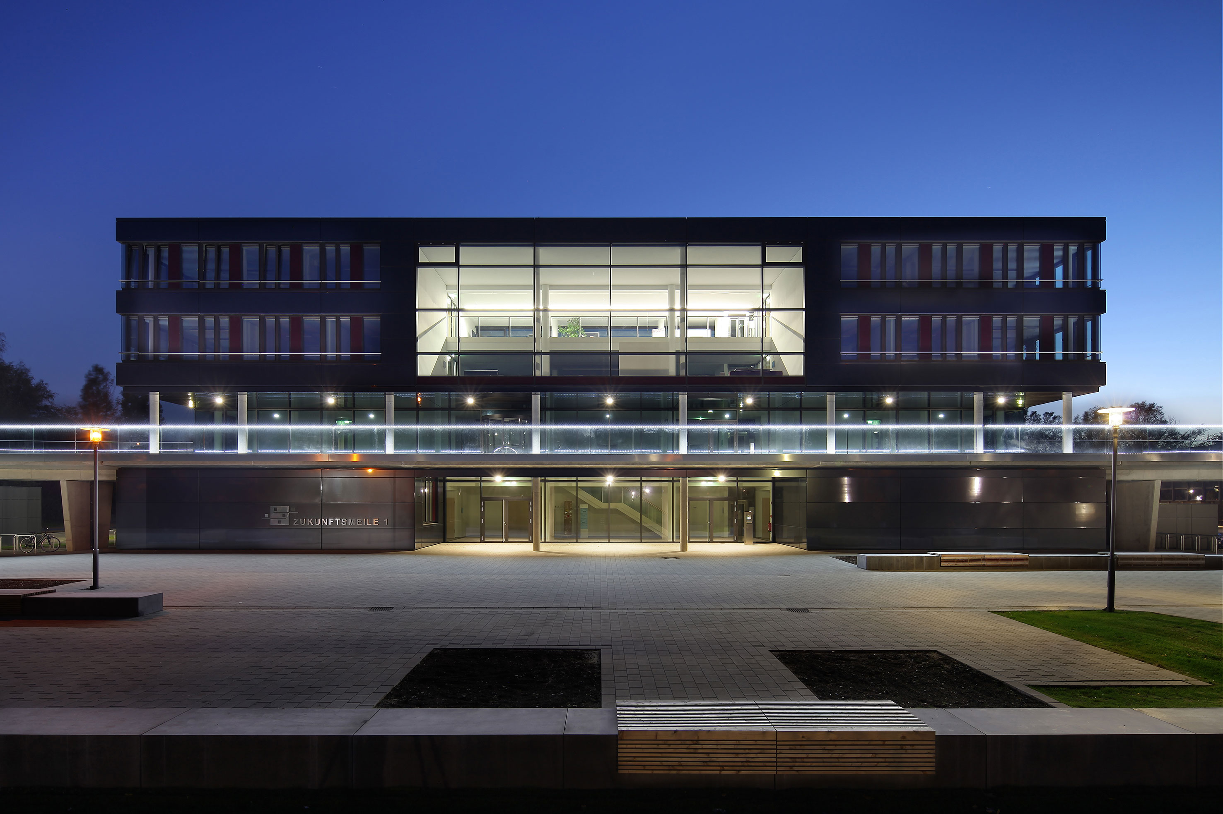
Foreign Object Detection System

Slide 2
Foreign Object Detection System
6987112 Lal, Amal Nimmy
4011205 Deshwal, Aryman
6818900 Eranki, Varun Maitreya
4025318 Kothandaraman, Jagannath
6757069 Illapogu, Pranuthi

Slide 3

Agenda
Introduction
System Engineering
Concens
SysML
Summary

Slide 4
INTRODUCTION
1

Slide 5

Critical role in aircraft safety
Integration of cameras, LIDAR, and RADAR
Artificial Intelligence for threat detection
Stakeholder notification system
Continuous monitoring of runways and taxiways
Part of Intelligent Airport System (IAS)

Slide 6
SYSTEM eNGINEERING
2

Slide 7
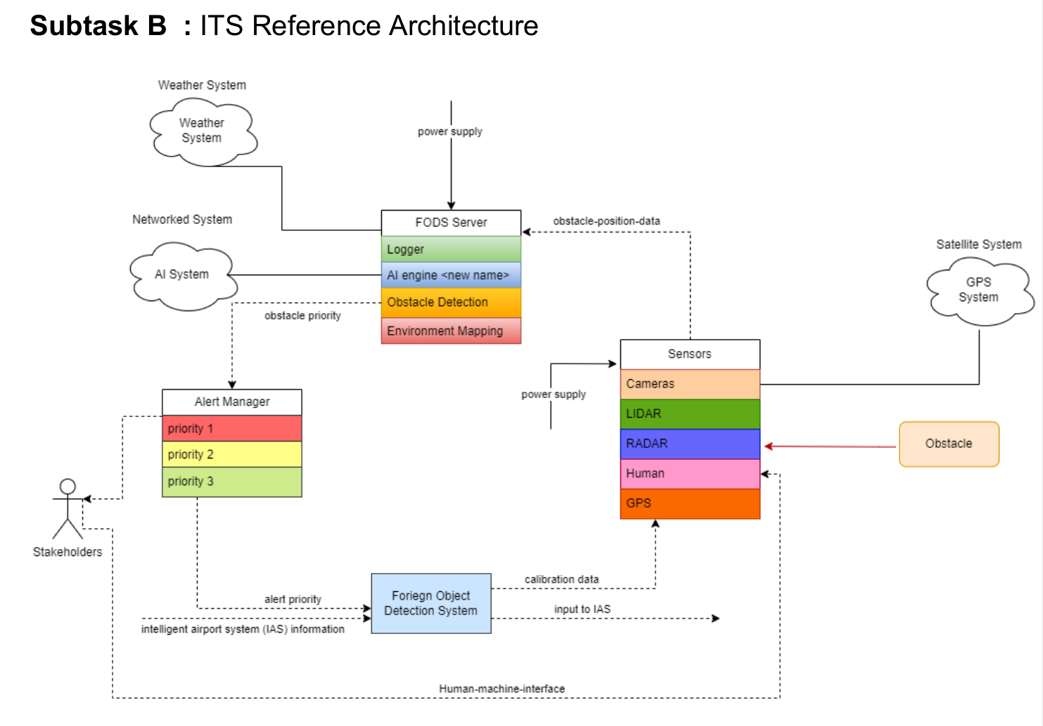
Architecture Diagram

Slide 8
CONCENS
3

Slide 9
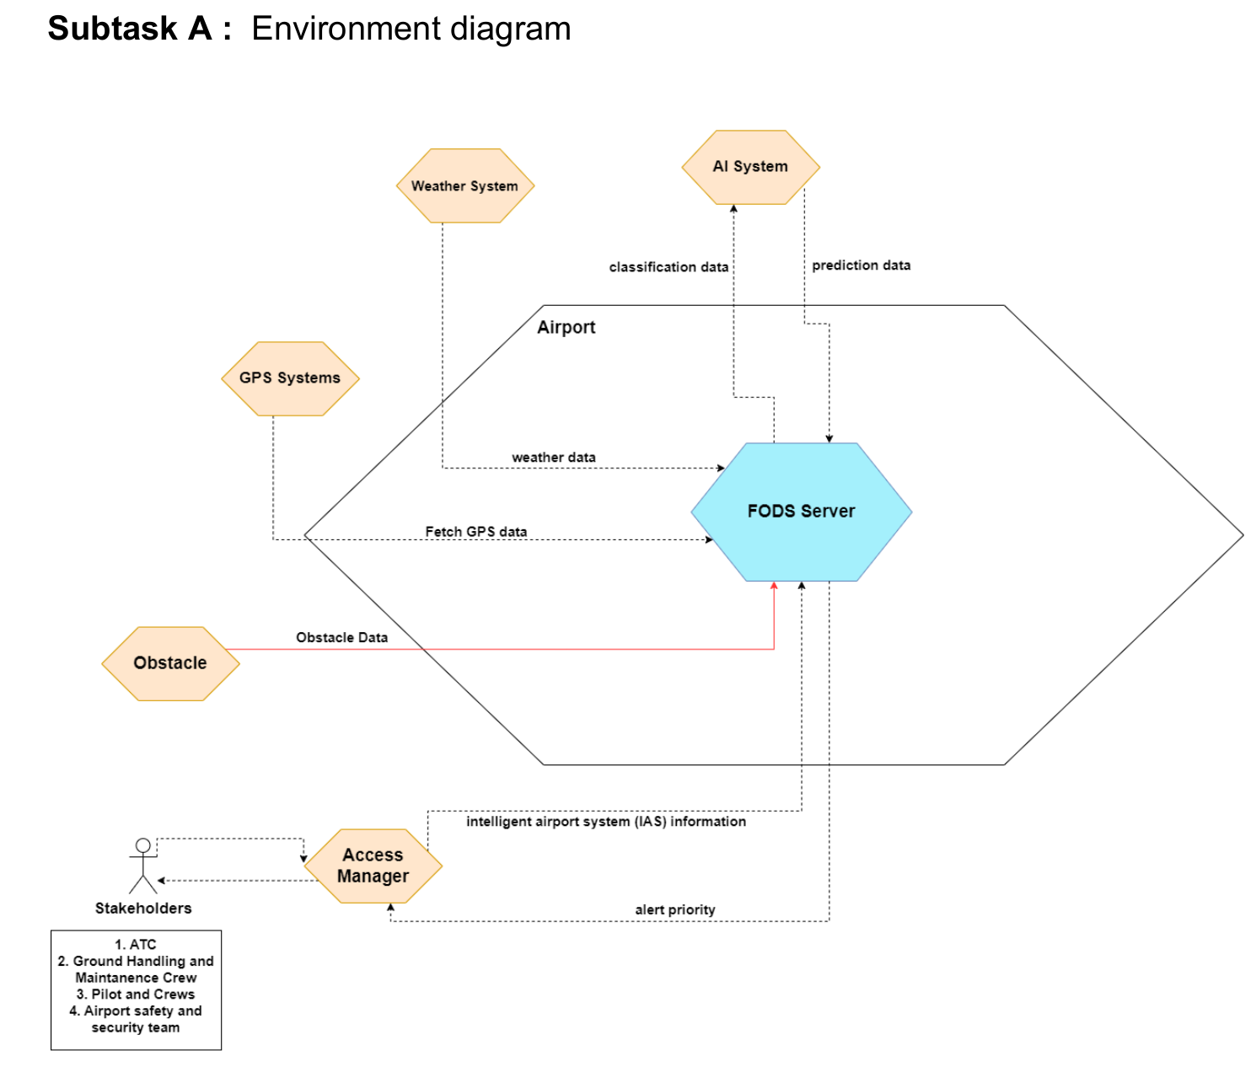
Environment Diagram

Slide 10
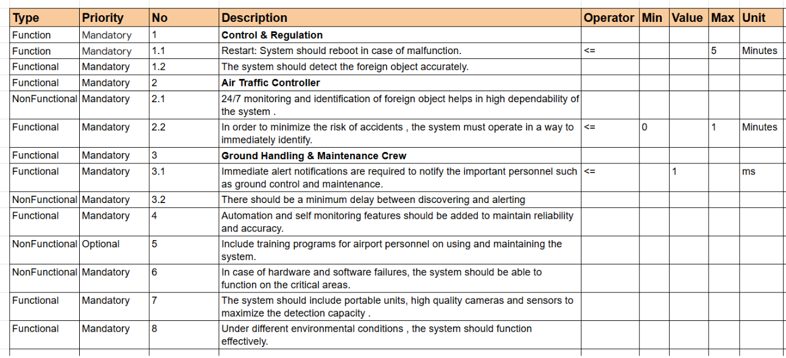
Functional and Non-Functional Requirements

Slide 11
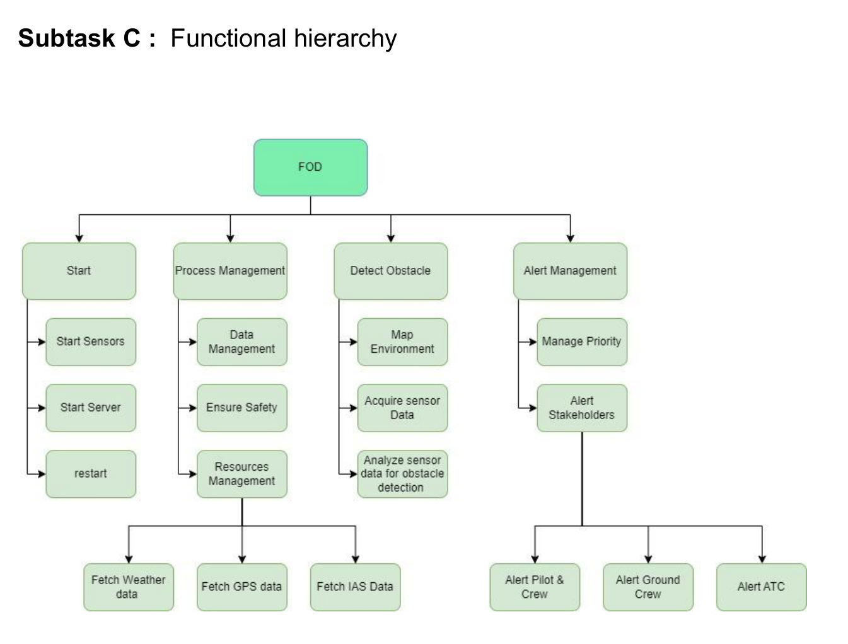
Functional Heirarchy

Slide 12
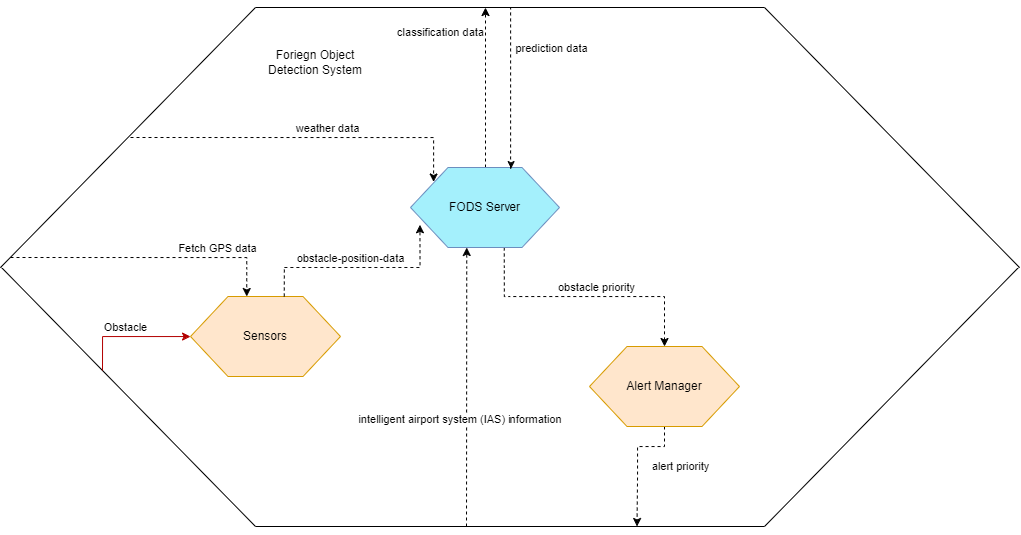
Active Structure

Slide 13
sYSML
4

Slide 14
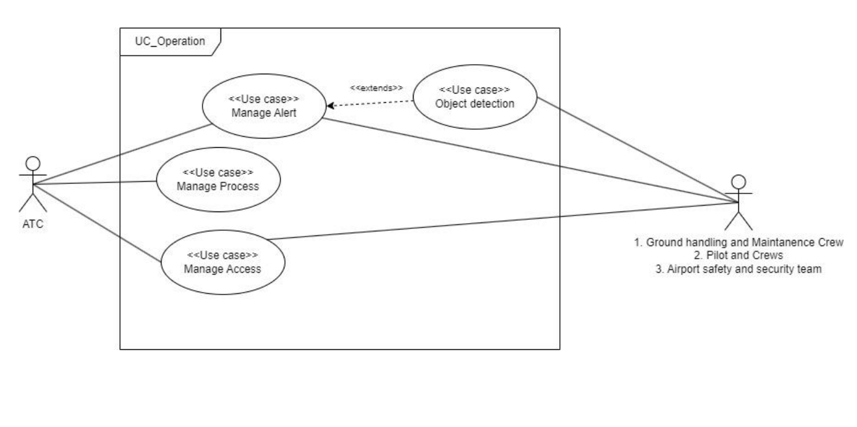
Usecase Diagram

Slide 15
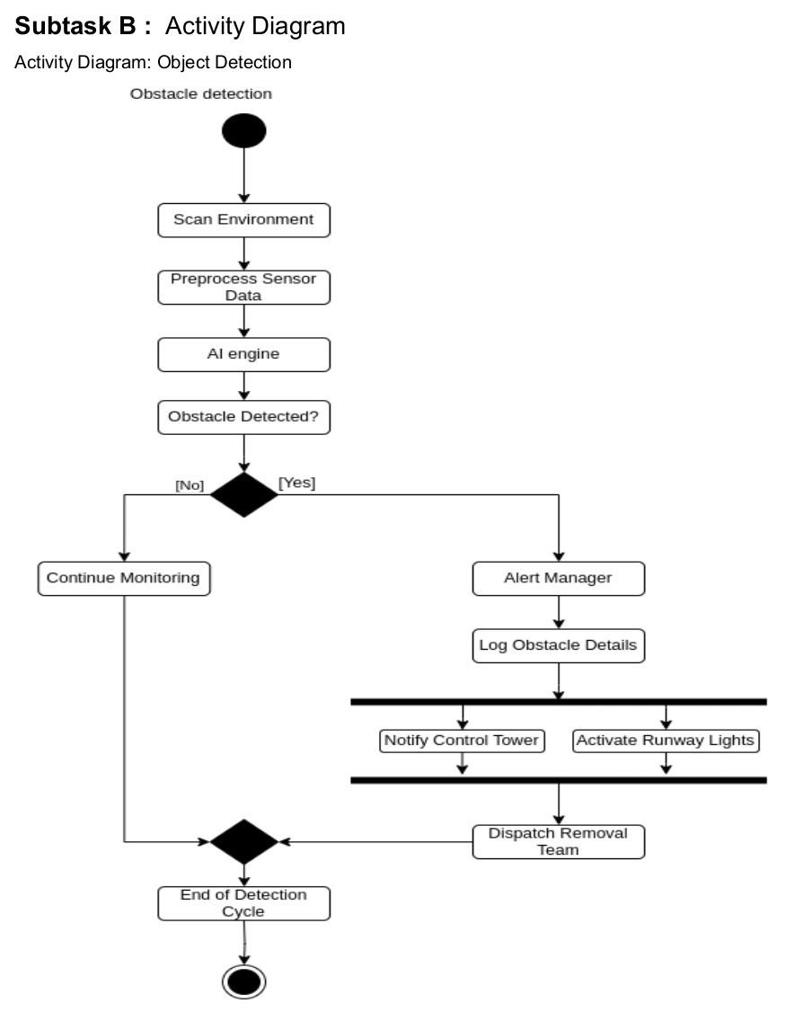
Activity Diagram
Object Detection
1. Scans Environment
2. If Object detected
Alert Manager
Logs Obstacle Data
Notify Stakeholders
3. If Object not detected
Continue scanning

Slide 16
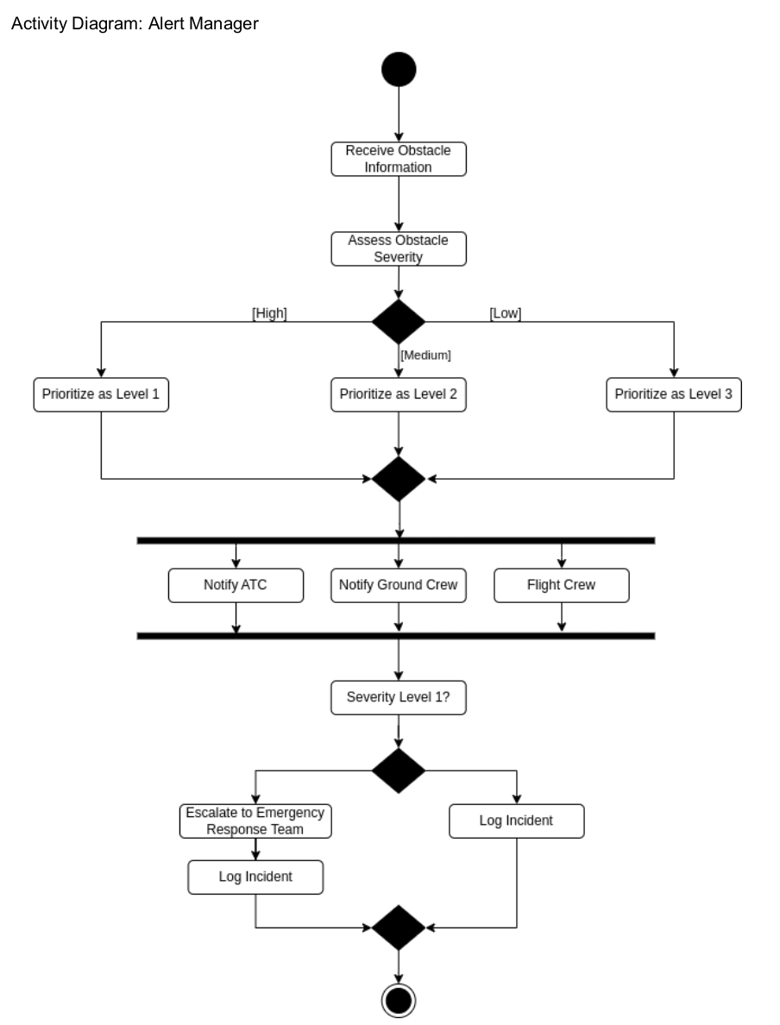
Activity Diagram
Alert Manager
1. Receives Obstacle Information
2. Checks Severity
3. Notify Stakeholders

Slide 17
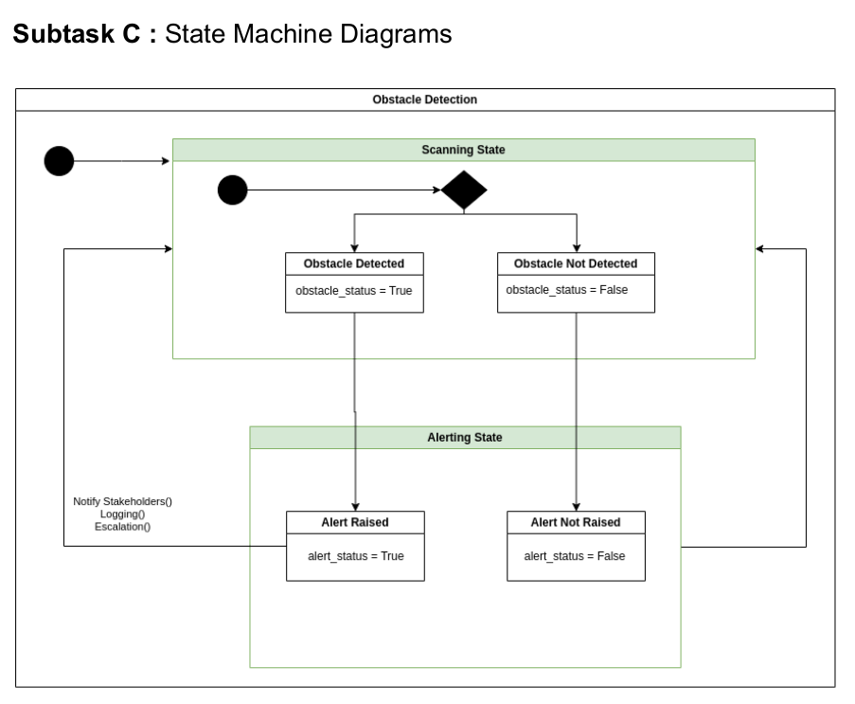
State Machine Diagram
Object Detection
1. Scanning State
Obstacle Detected
Obstacle Not Detected
2. Alerting State
Alert Raised
Alert Not Raised

Slide 18
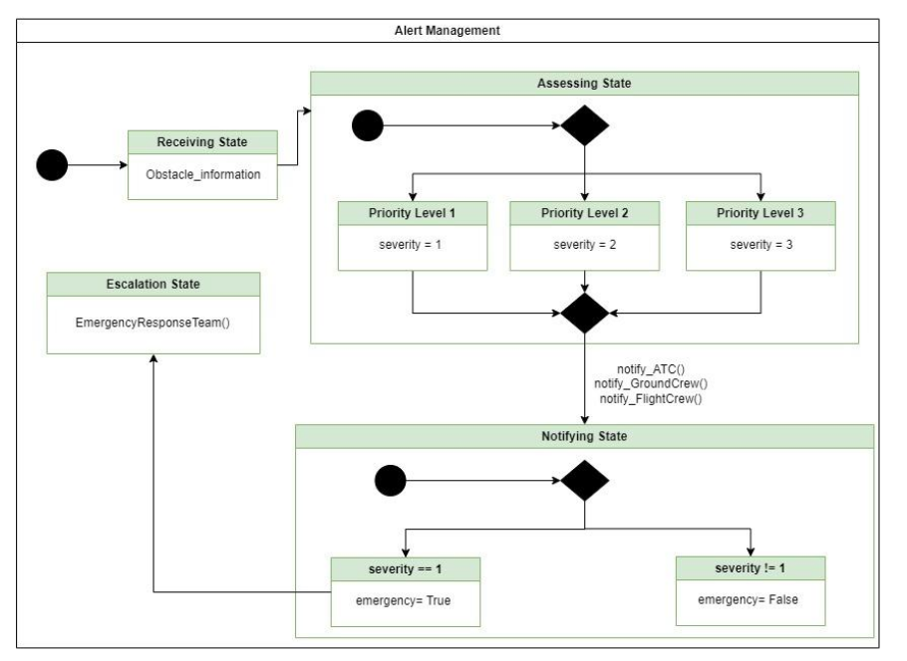
State Machine Diagram
Alert Management
1. Assessing State
2. Receiving State
3. Escalation State
4. Notifying State

Slide 19
FODS is an integral part of IAS system.
It is also a safety critical system.
It helps in prioritizing the alerts
Helps stakeholders take sequential actions.
It uses modern AI tools, GPS systems, cloud services to create a map of airport and detect foreign objects in the map.

Slide 20

Thank you for your attention
Hintergrundbild-Platzhalter ist deaktiviert
→ über Menü „Start“ → Reiter „Bearbeiten“ → „Markieren“ → „Auswahlbereich“ → Ebene „Bild“ Symbol „Auge“ aktivieren → Bild in Platzhalter einfügen
!

